Slide 1
Parallelization and gpu computing

Slide 2
Why gpu?
Parallelism and GPU computing
AI calculations involve quite a few arithmetic calculations.
Graphics processing units (GPUs) are computer chips that were designed to parallelize large numbers of small arithmetic calculations.
They were designed as such because computer graphics involve rotations, shifts, scaling, etc. of images, are matrix or tensor manipulations, i.e. a large collection of small arithmetic calculations.
This discussion is relevant, since there is a calculus of parallelization on whether or not it will be worth the effort.
Some cases parallelization can slow down computations.

Slide 3
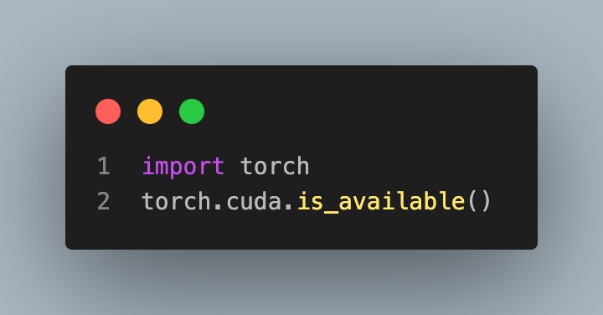
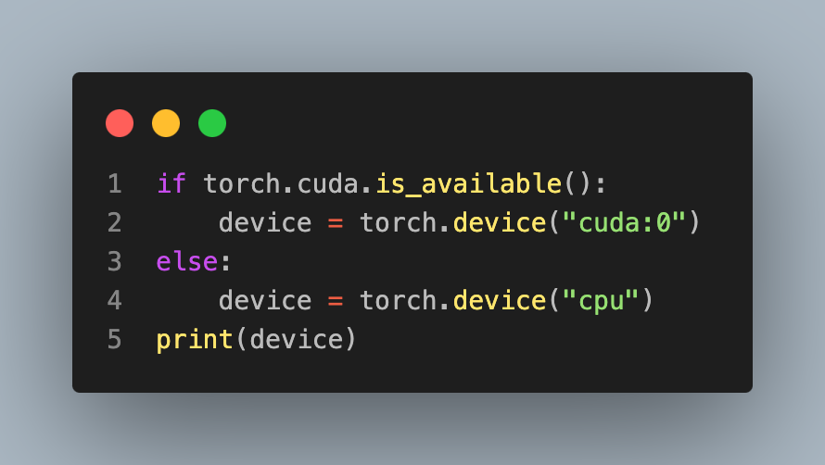
GPU computing for pytorch
True
cuda:0

Slide 4
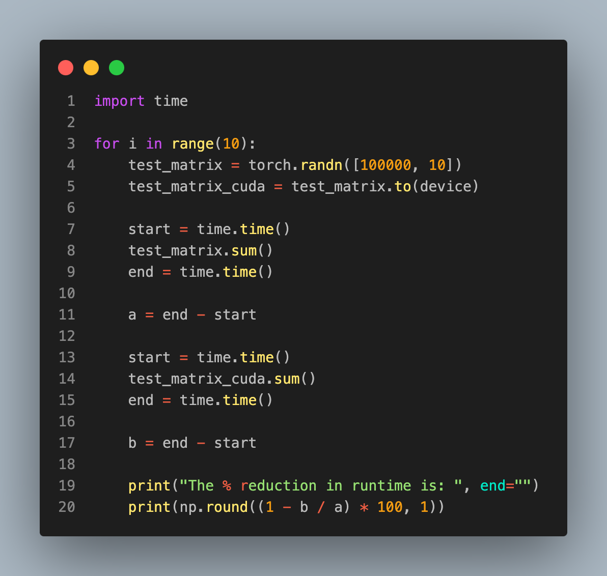
Testing it out
The % reduction in runtime is: 68.8
The % reduction in runtime is: 65.8
The % reduction in runtime is: 58.7
The % reduction in runtime is: 59.1
The % reduction in runtime is: 28.6
The % reduction in runtime is: 60.8
The % reduction in runtime is: 42.1
The % reduction in runtime is: 52.8
The % reduction in runtime is: 57.5
The % reduction in runtime is: 62.1

Slide 5
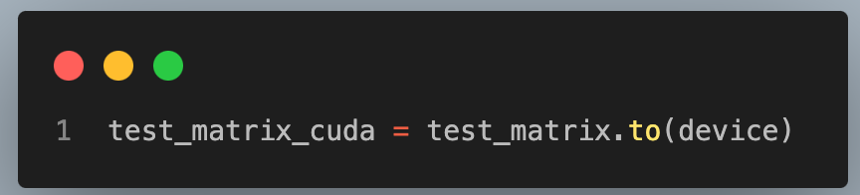
Testing it out
The % reduction in runtime is: 68.8
The % reduction in runtime is: 65.8
The % reduction in runtime is: 58.7
The % reduction in runtime is: 59.1
The % reduction in runtime is: 28.6
The % reduction in runtime is: 60.8
The % reduction in runtime is: 42.1
The % reduction in runtime is: 52.8
The % reduction in runtime is: 57.5
The % reduction in runtime is: 62.1

Slide 6
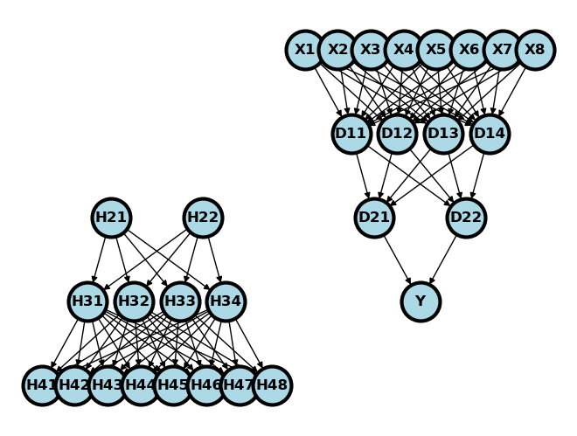
GANs

Slide 7
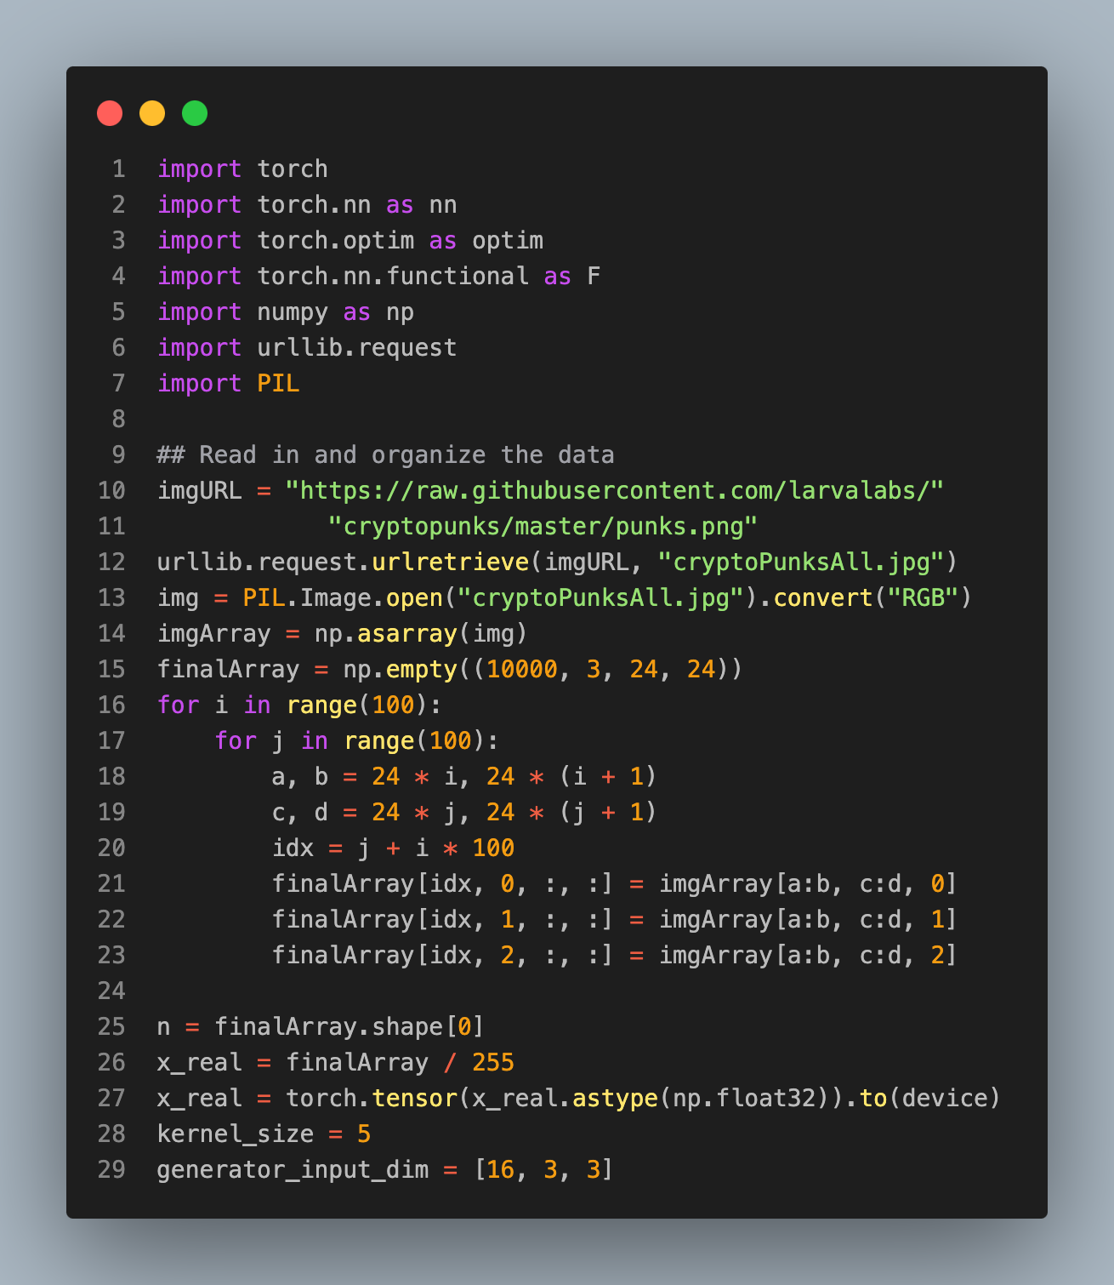
GAN example

Slide 8
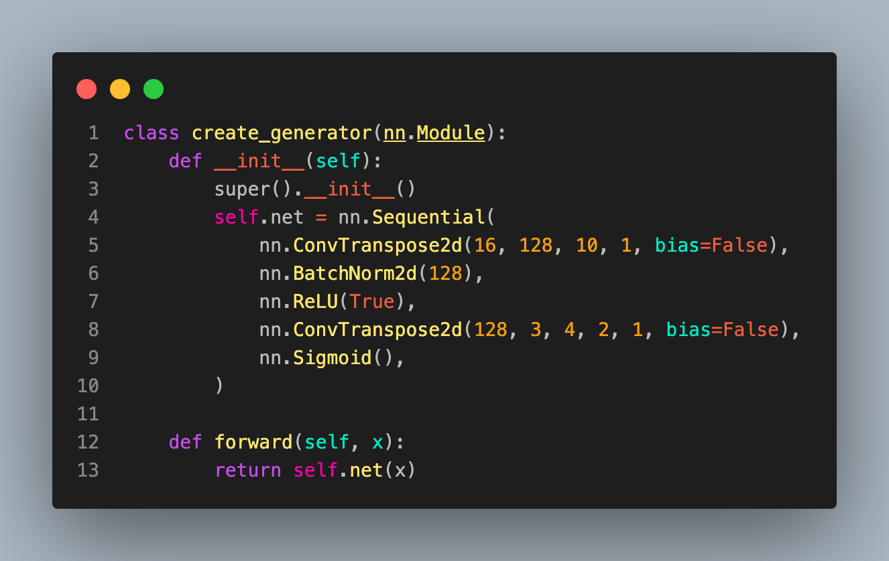
Generator versus discriminator

Slide 9
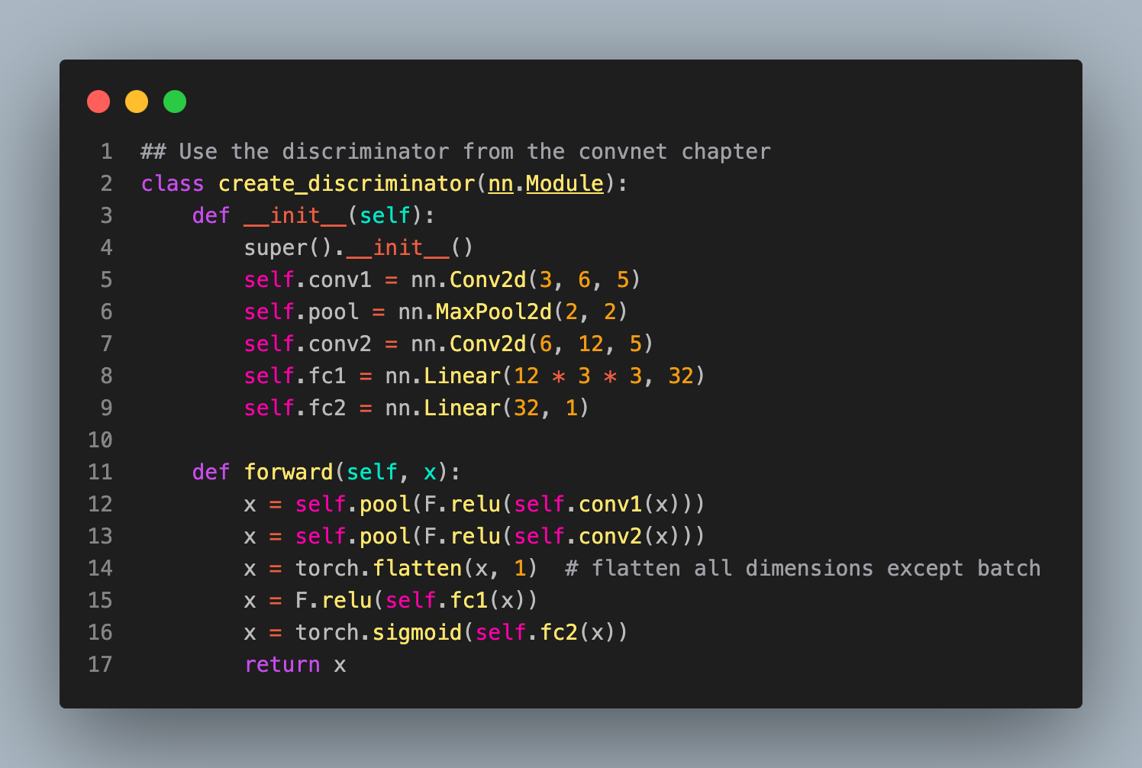
Generator versus discriminator

Slide 10
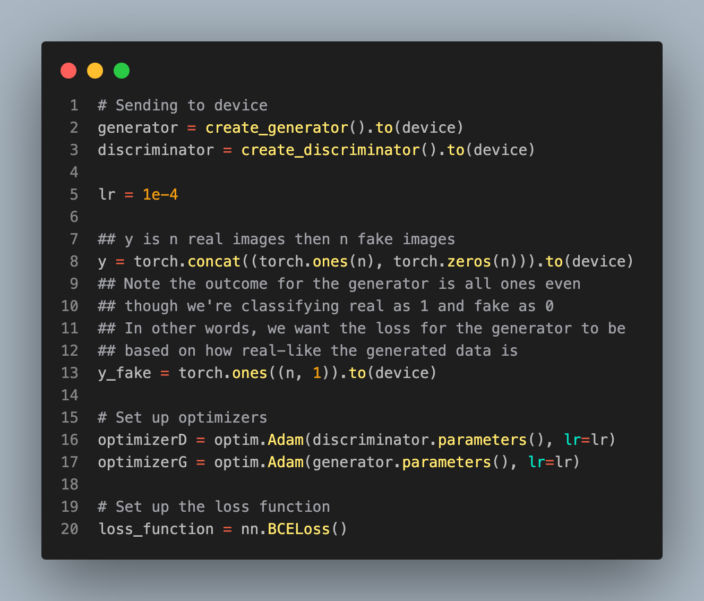
Sending to device

Slide 11
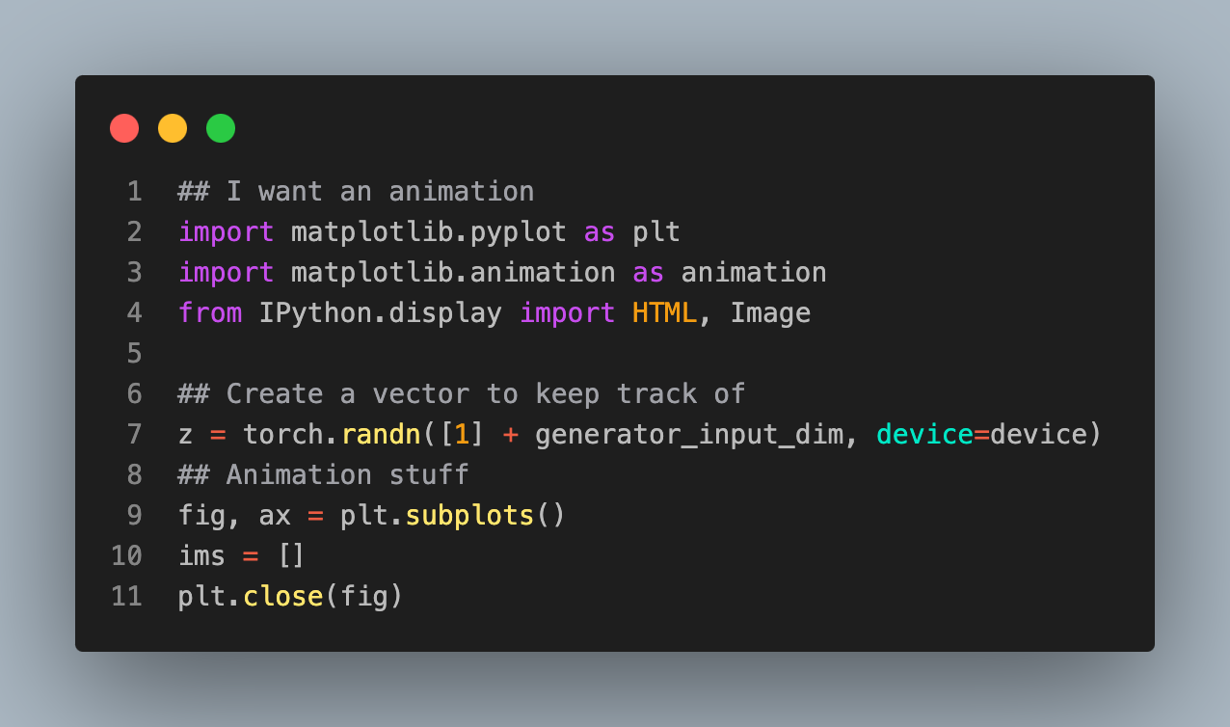
Aside, getting an animation

Slide 12
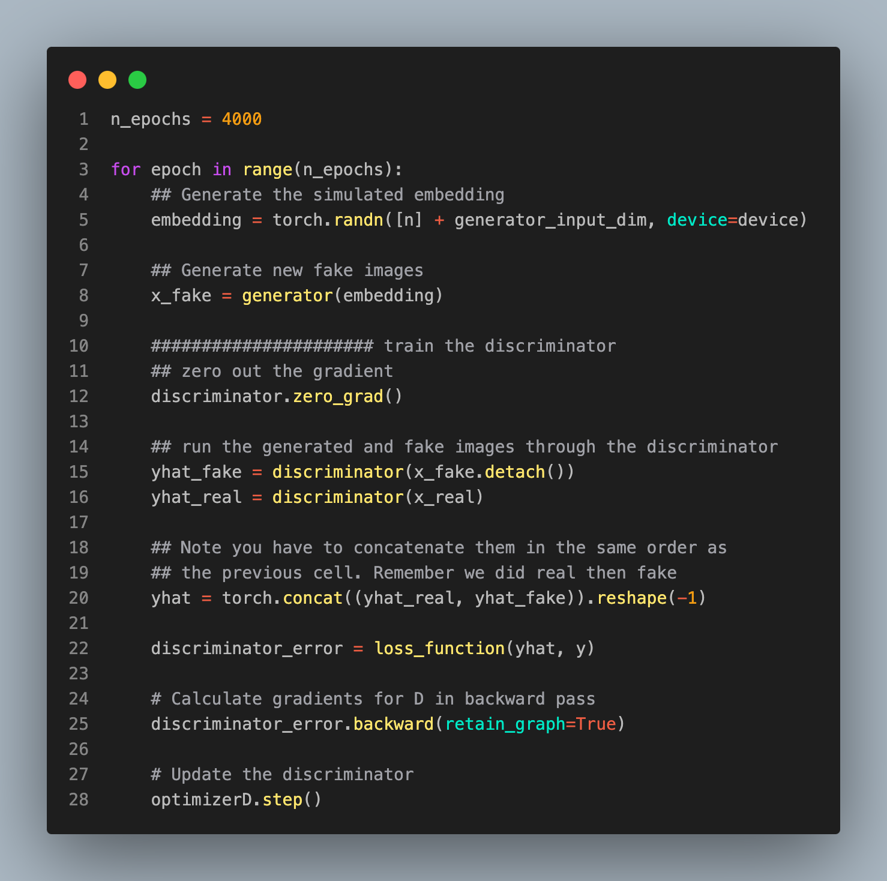
Running the model

Slide 13
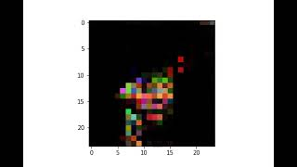
The result

Slide 14
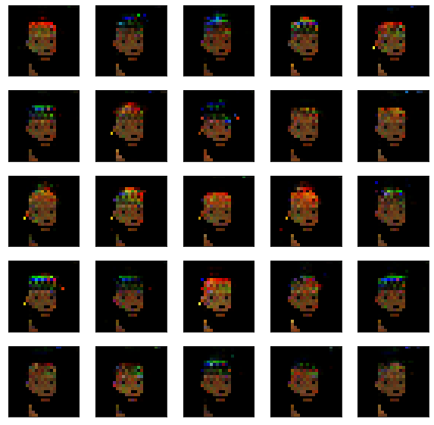
The result

